Slide 1
Experiment Minerals
&
Their Properties

Slide 2
Komatiite
High degree partial melts of Peridotite
Ultramafic/Volcanic Specimen
Samples are rare

Slide 3
Peridotite
Ultramafic/Plutonic Specimen
Samples are abundant and easily accessible

Slide 4
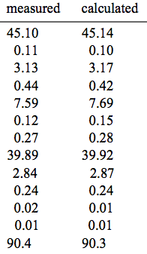
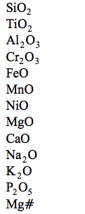
Composition Comparison
Peridotite
Komatiite
1 2 3
*
SiO₂ | 46.80 | 49.40 | 47.20
TiO₂ | 0.38 | 0.11 | 0.14
Al₂O₃ | 4.43 | 7.60 | 4.61
FeO (tot) | 11.45 | 5.40 | 8.30
MnO | 0.18 | 0.12 | 0.14
MgO | 30.28 | 30.80 | 34.80
CaO | 5.78 | 5.40 | 3.73
Na₂O | 0.07 | 0.34 | 0.41
K₂O | 0.01 | 0.01 | 0.02
*
*
*
*
*
*
*
*
*
http://www.geol.umd.edu/~rudnick/Webpage/Eggins_1998_EPSL.pdf
Komatiite Nicholas Arndt

Slide 5
Liquid Komatiite
Eruption Temperature slightly above 1650˚C
“Komatiite liquids have extreme chemical compositions, being very rich in MgO and poor in SiO₂ and Al₂O₃”
T_{liq} = MgO_{liq} × 20 + 1000
  MgO_{liq} in weight per cent
  at 1 atm
  T_{liq} in ˚C
Komatiite Nicholas Arndt

Slide 6
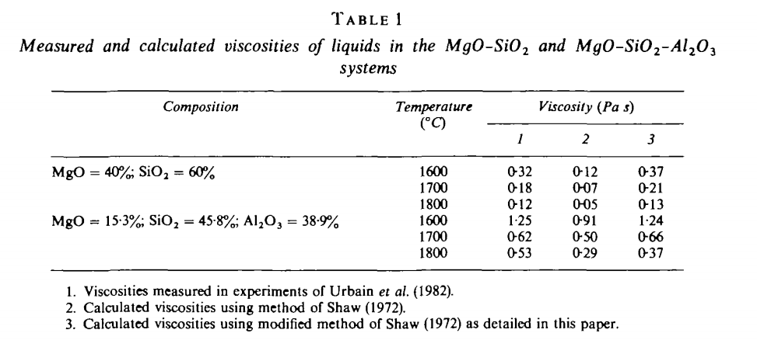
http://www.itg.cam.ac.uk/people/heh/Paper66.pdf

Slide 7
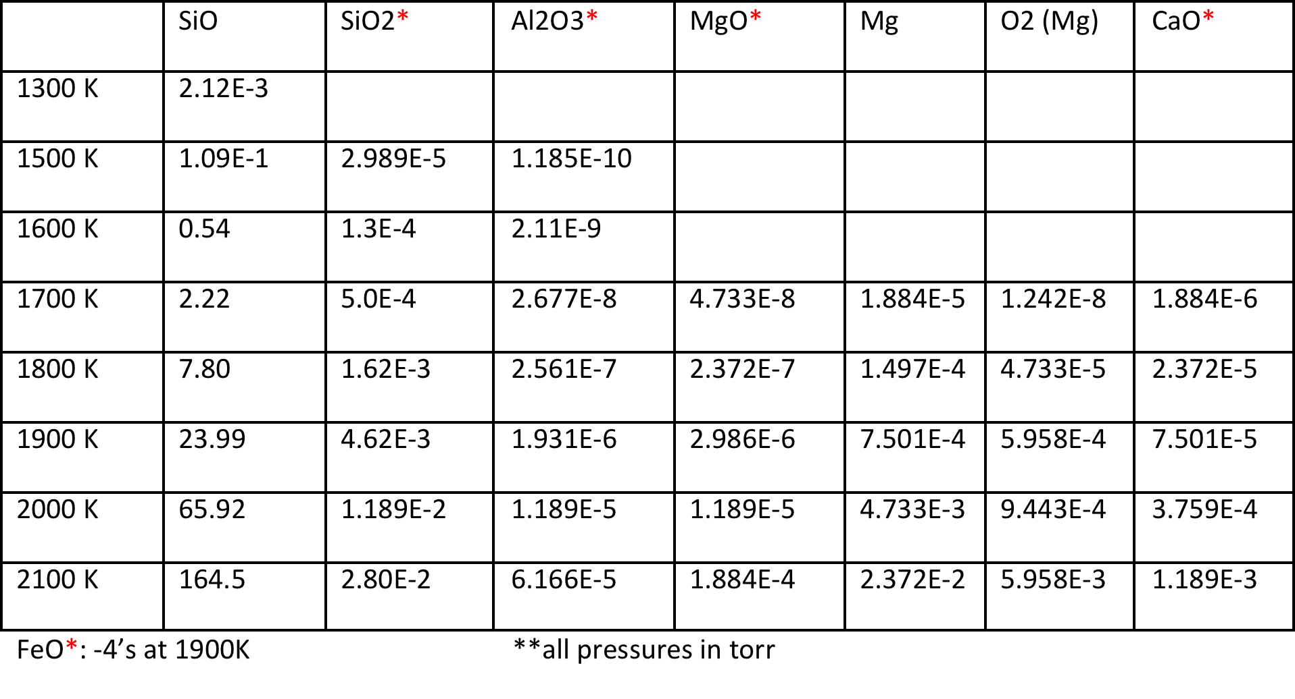
Constituent Vapor Pressures

Slide 8
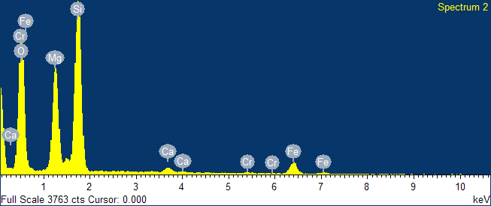
Rock Sample

Slide 9
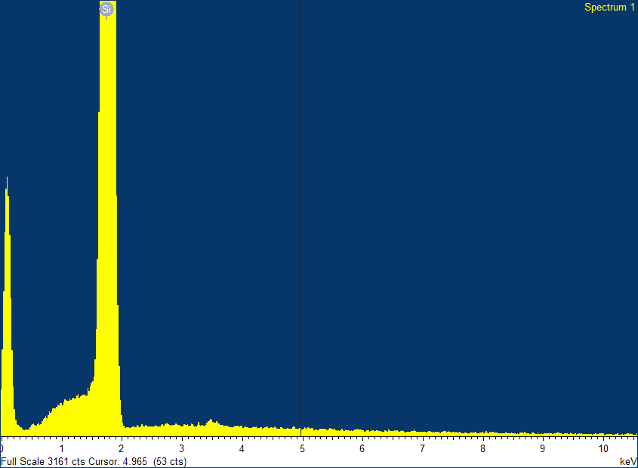
Deposition on Si

Slide 10
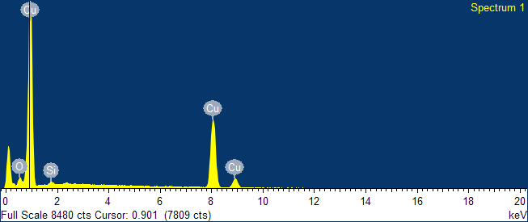
Deposition on Cu

Slide 11
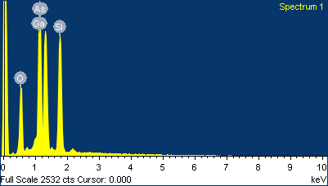
Deposition on GaAs

Slide 12
Addition of Water
“At high pressures, volatiles are soluble in silicate liquid and their presence depresses the liquidus by roughly 10˚C for each per cent of dissolved H₂O or CO₂”

Slide 13
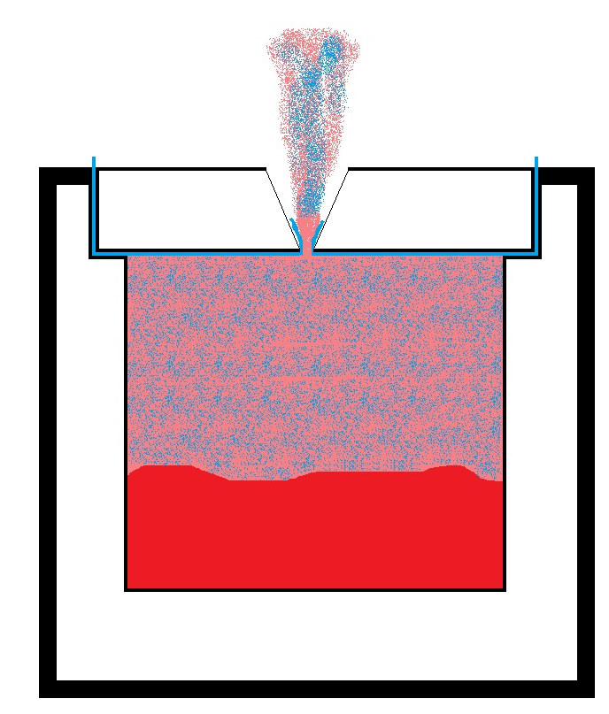
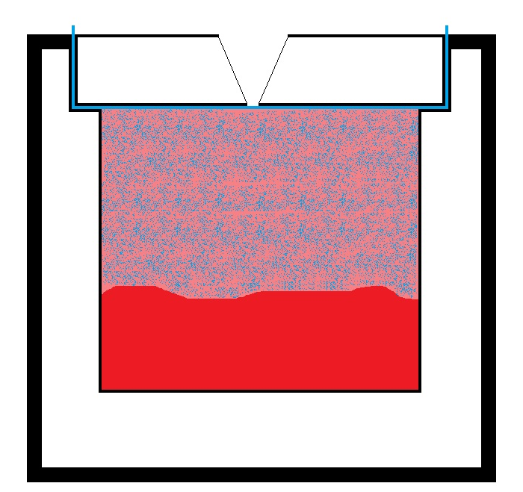
How to Incorporate Water

