Slide 1
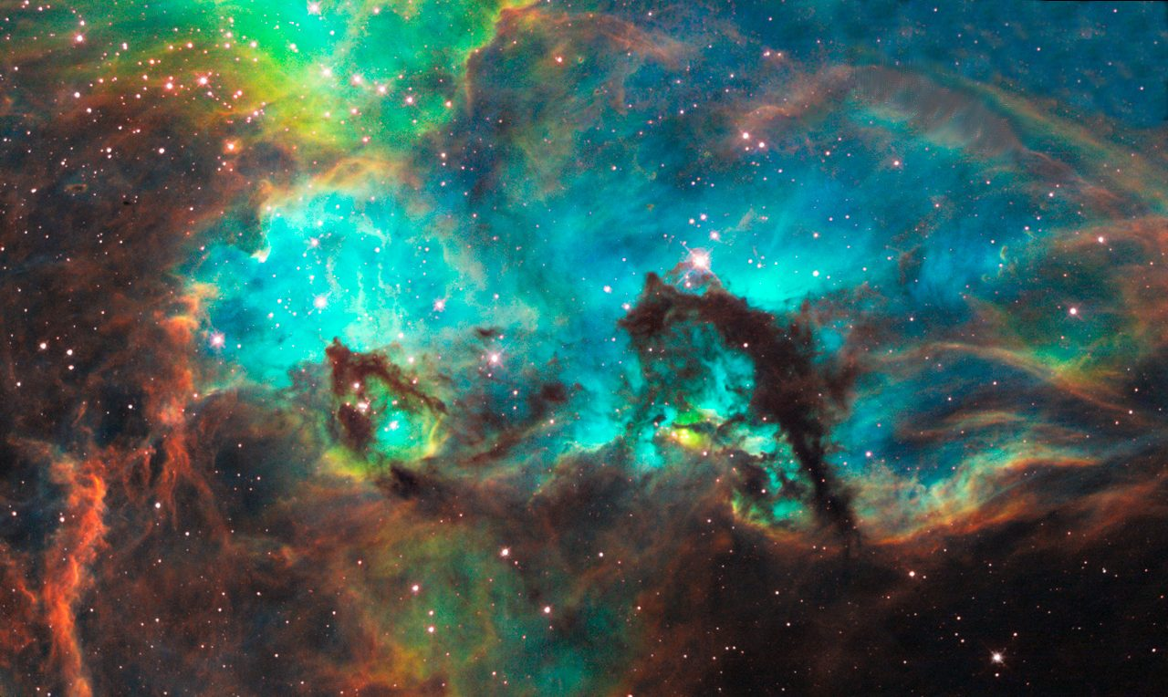
Welcome to Astronomy 115 http://sdbv.missouristate.edu/mreed/CLASS/A115
“ It would seem that you have no useful skill or talent whatsoever, he said. Have you thought of going into teaching?”
Mort, by Terry Pratchett

Slide 2

Astronomy 115
Dr. Mike Reed
    Office: 103L Kemper Hall
    Phone: 836-5131
    e-mail: mikereed@missouristate.edu
    Office Hours: M,W,F 8:30-9:55 am
    Tuesdays & Thursdays I work remotely; we can always schedule a zoom session.

Slide 3
Emergency stuff (in syllabus too)
Shelter information: Move to lower level using east and west stairs. Avoid south central stairwell. Shelter in movable shelving area on basement level.
Emergency Assembly Point: West to Glass Hall room 101; Alternate: South to Blunt Hall.

Slide 4
http://sdbv.missouristate.edu/mreed/CLASS/A115
The textbook is on-line (pdf or html).
    Lecture notes will be posted after class.
    Please let me know if you need help accessing the web, or if the web pages are not working.
    Brightspace for grades, syllabus, on-line textbook.
    Labs scores will be included on our main brightspace page- not separate lab pages.

Slide 5
Grading
Based on answers, not effort.
Test- 300 points
    Tests will be part multiple choice, part short answer.
    Make-up tests are all short answer!
Homework and in-class assignments- 200 points
    ~4 Homework, ~4 in-class assignments.
Quizzes- 150 points
    There will be 17 quizzes given throughout the semester. The 2 lowest quiz scores will be dropped at the end of the semester.
    You must use your clickers for these (allowed 2 exceptions).
Group Projects- 100 points. 2 projects.
Labs- 260 points.

Slide 6
Tests
We will have three 1 hour section tests (25-30 questions each).
If you want, rather than taking the last section test, you can take a longer (about 50 questions) comprehensive final. That score will count as your last section test score and replace any lower section test scores.
But you cannot replace two 0 scores with a comprehensive final.

Slide 7
Group Projects
There will be two group activities (50 points each).
You will work in groups to complete the activity and turn in one set of written answers with your names on it.

Slide 8
Homework
HW will be assigned (often out of the book), and you will do it on paper. On the due date, I will have converted the questions to multiple choice, which you will answer on your paper.

Slide 9
In-class Assignments
We will do several in-class assignments during the semester.
These will be done in small groups.
Seating will be assigned (a seating chart will be posted).
Each group member receives the same score.
Some times you may need to do reading in advance.

Slide 10
Labs
You will have a lab this week, not just, “Hi, how are you?”
You will receive all necessary lab materials (including printed labs) during your lab.
Some labs require pre-lab reading. Your lab instructor, will notify you.
On blackboard, lab scores will appear as Lab 1, Lab 2, Lab 3, etc. which corresponds to the week.
Night labs will get to see stars at our observatory, day lab will look at sunspots at some point.

Slide 11
Labs on Brightspace
Labs will total to 260 points.
Each lab is 20 points, with 13 labs in total.

Slide 12
Turning Technologies ‘clicker’
These will be used for quizzes and general questions.
Also called Point Solutions or responseware.
  Need a license (it costs)
  Need to link our course.

Slide 13
Any questions on grading or work?

