Slide 1

“We demand rigidly defined areas of doubt and uncertainty.”
The Hitchhiker’s Guide to the Galaxy
http://sdbv.missouristate.edu/mreed/CLASS/A115
Reading updated: Chapters 4 and 8
Notes:
<number>
<number>

Slide 2
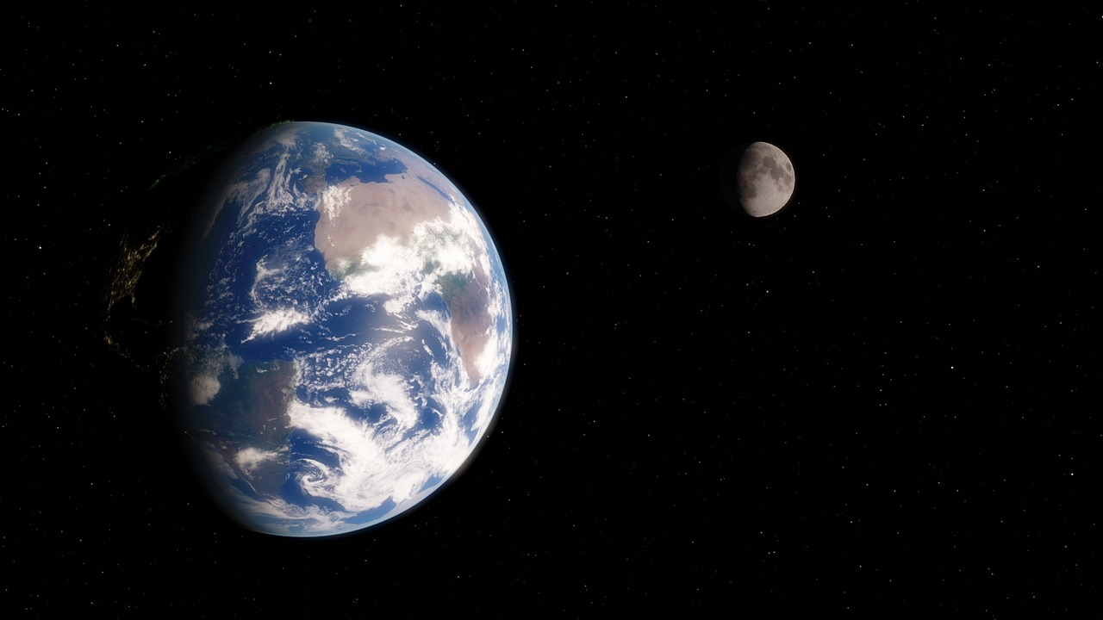
Baseline:
The Earth and Moon
Notes:
<number>
<number>
<number>

Slide 3
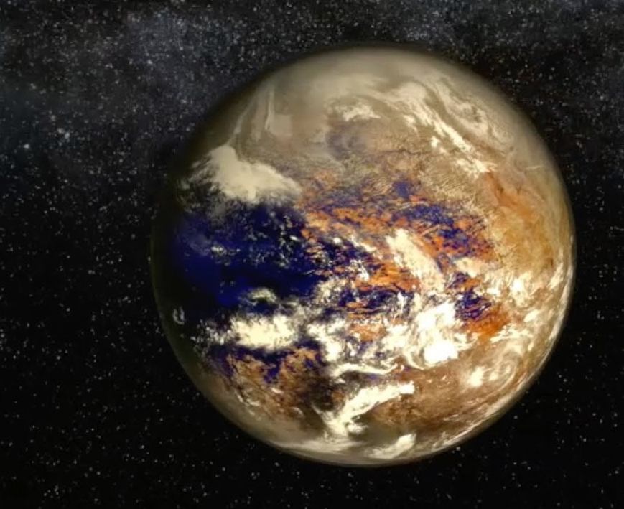
Notes:
<number>

Slide 4

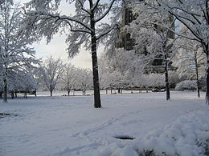
Earth's Seasons
We all know that summers are hotter than winters- why? Earth’s spin axis is tilted.
Notes:
<number>
<number>
<number>

Slide 5
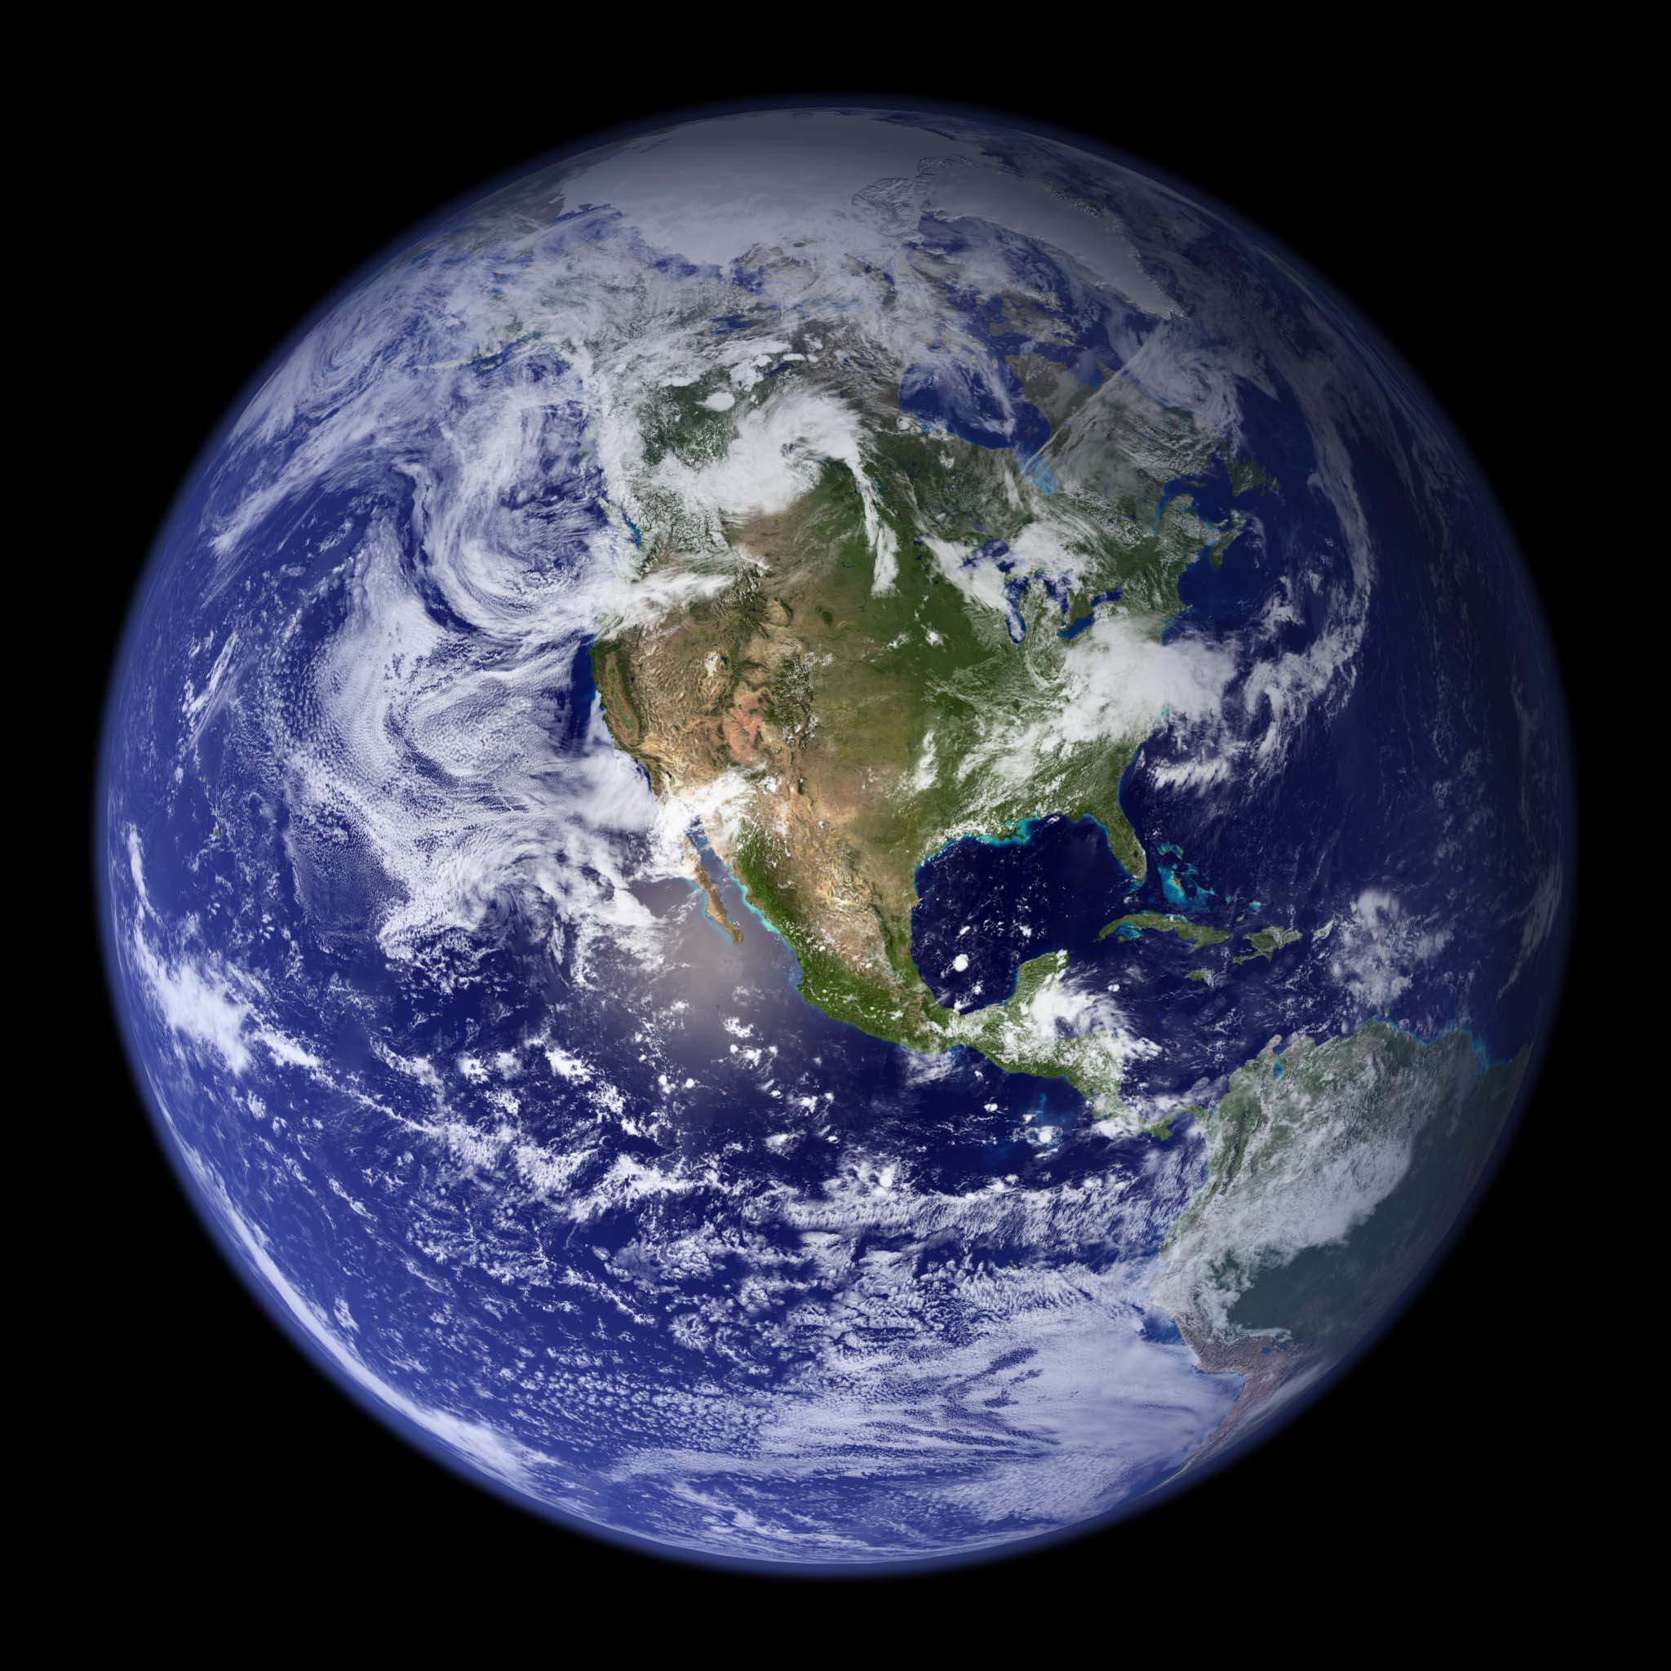
From this picture, write down what you see and what it
tells us about the Earth
Notes:
<number>
<number>
<number>

Slide 6
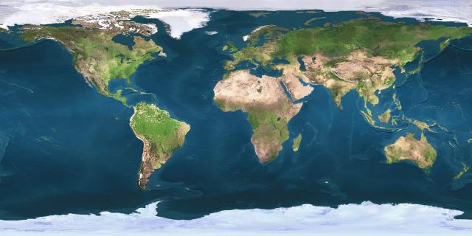
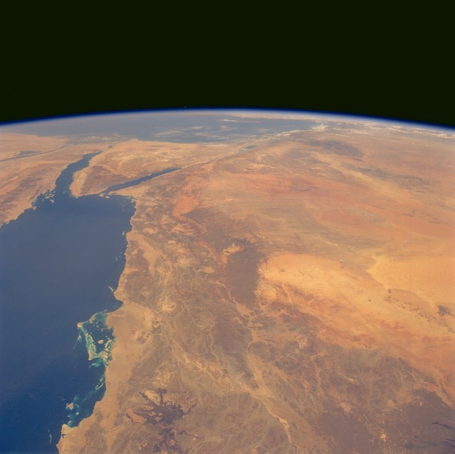
Same here.
Notes:
<number>
<number>

Slide 7
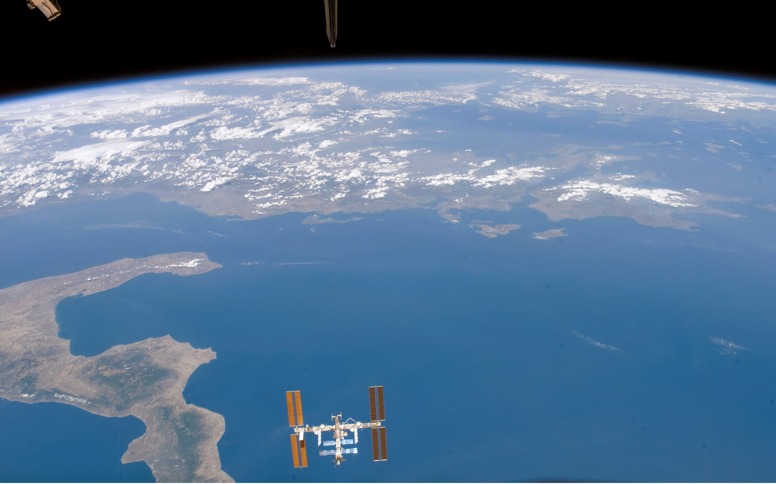
Notes:
<number>
<number>

Slide 8
Features we see and what they tell us.
Some Examples
Round- means it is massively big.
well-defined features: solid
Fuzzy-swirly features: gas: check with multiple images.
Smooth features: liquid
multiple colors- changes in temperature, composition, and/or altitude. Choose the best one!
There are always exceptions.
Notes:
<number>
<number>

Slide 9
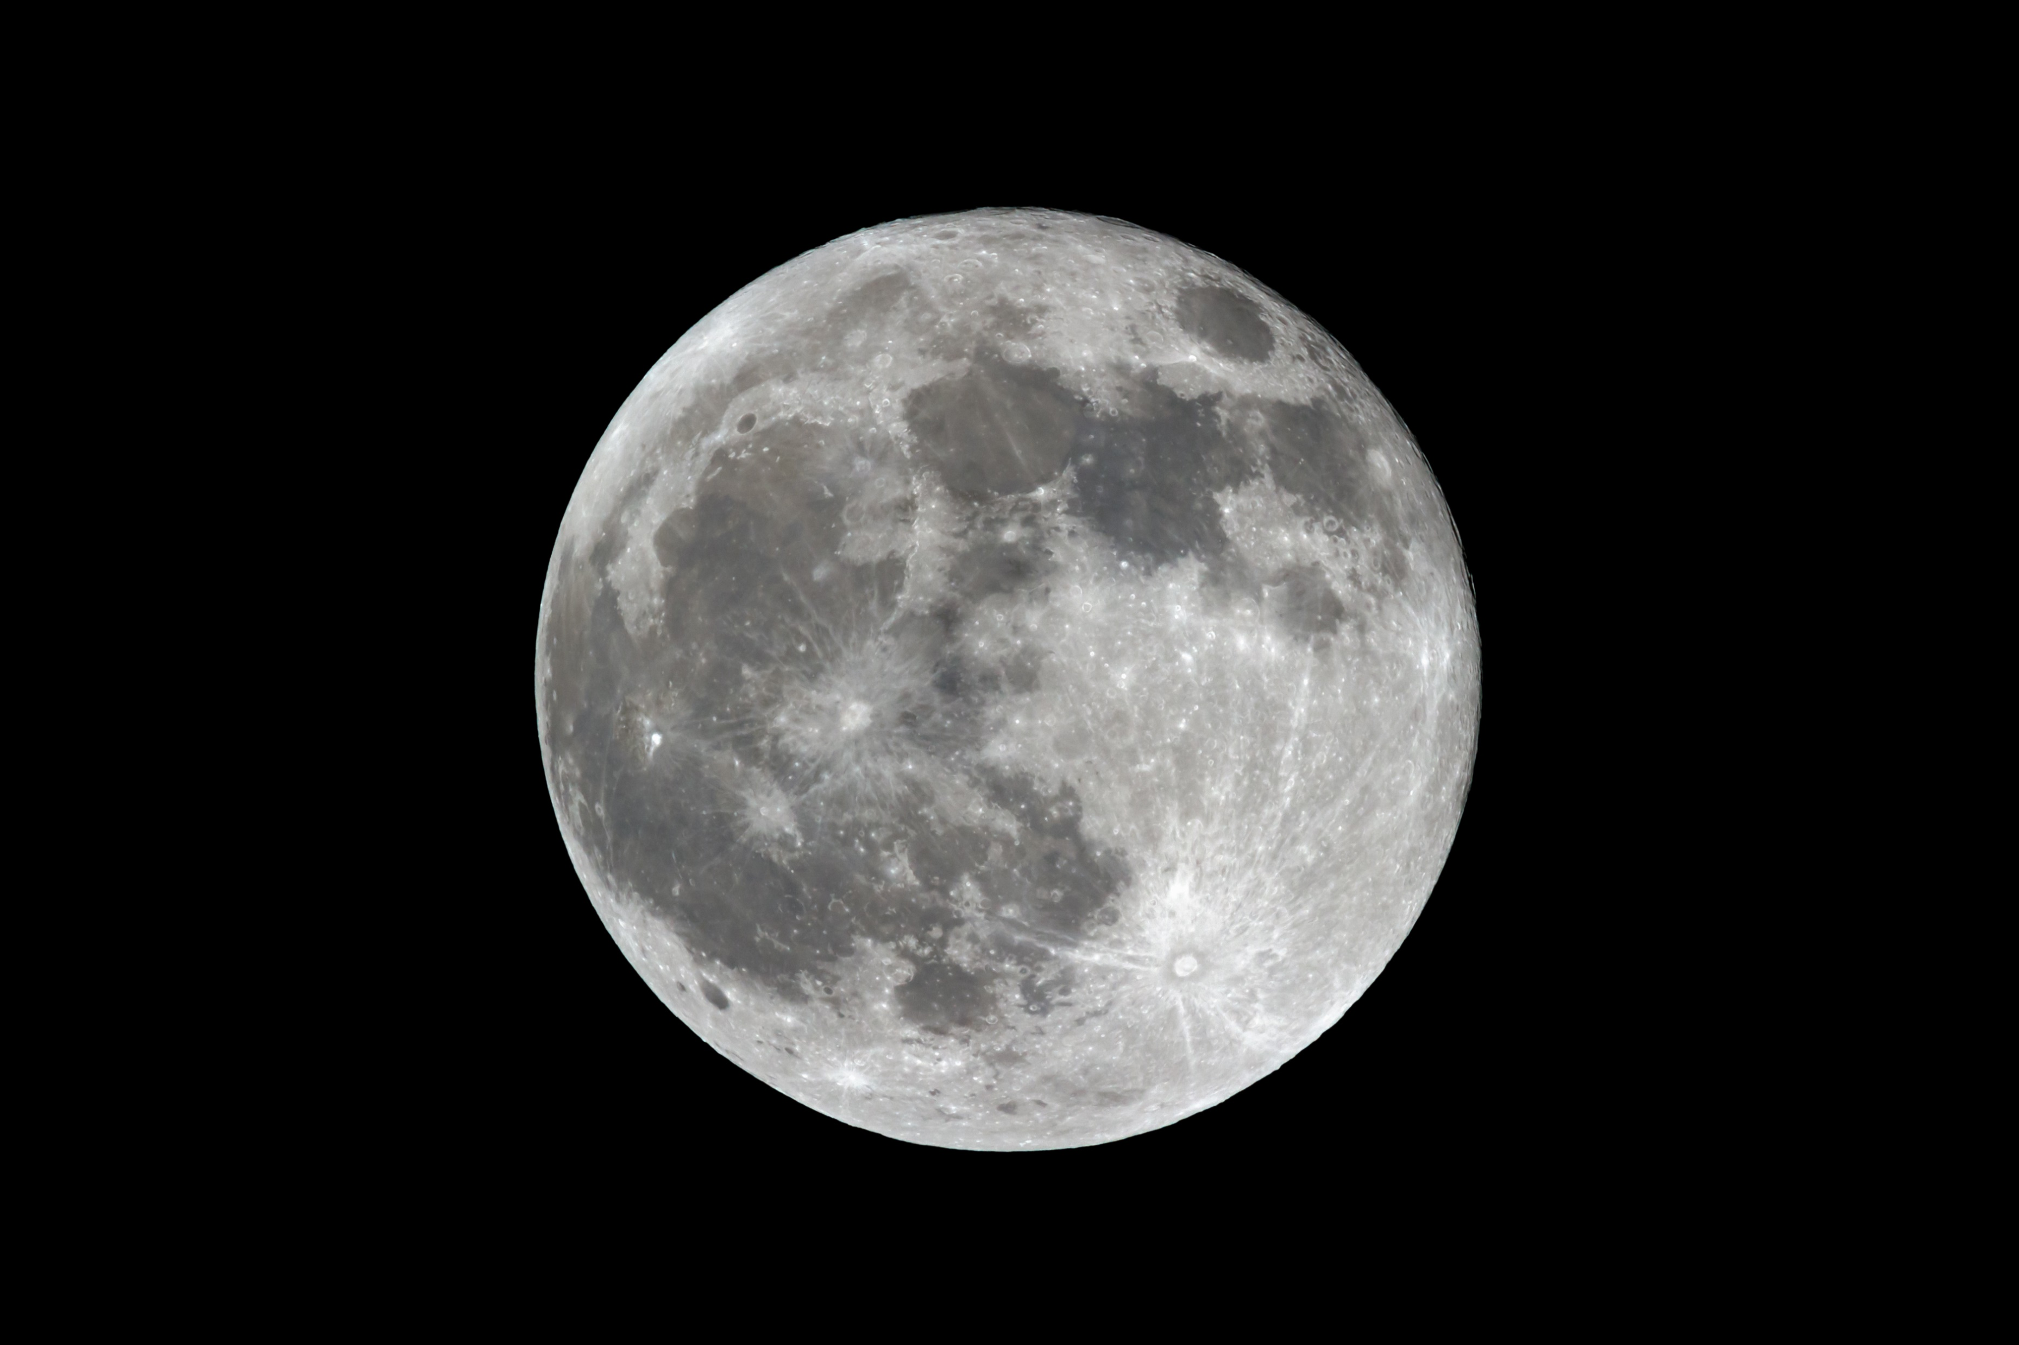
And now for the Moon
Notes:
<number>
<number>

Slide 10
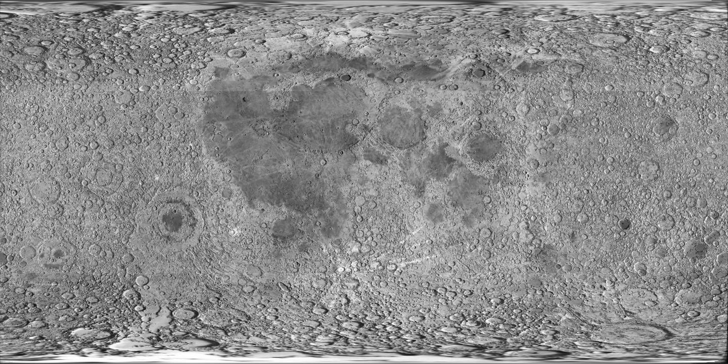
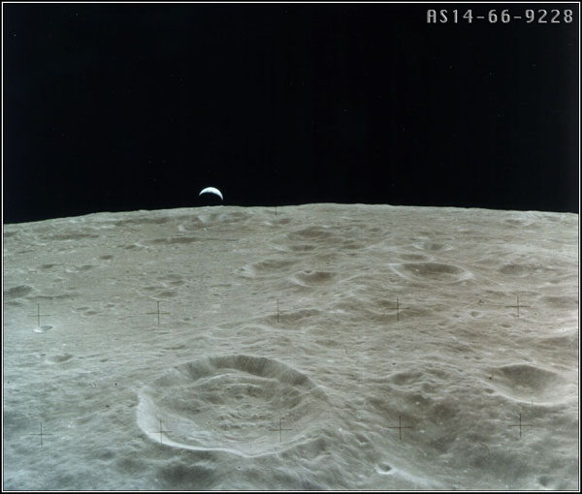
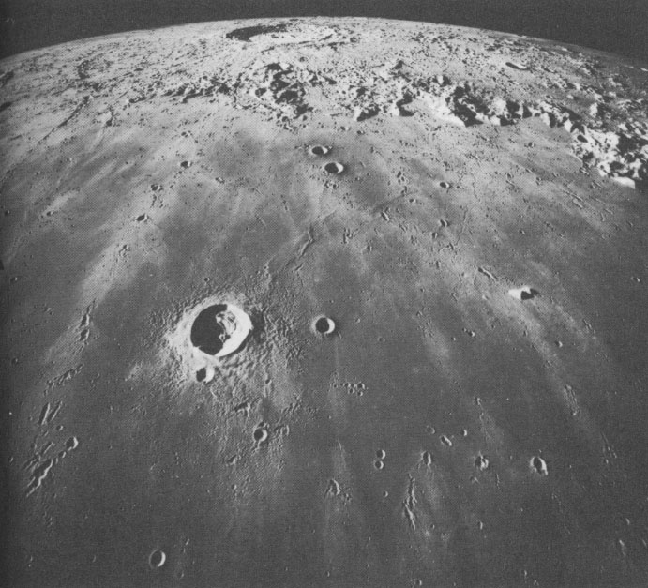
Notes:
<number>
<number>

Slide 11
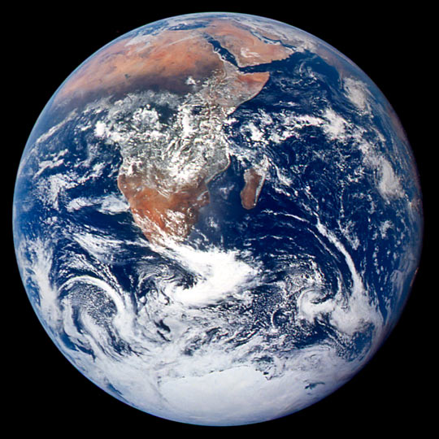
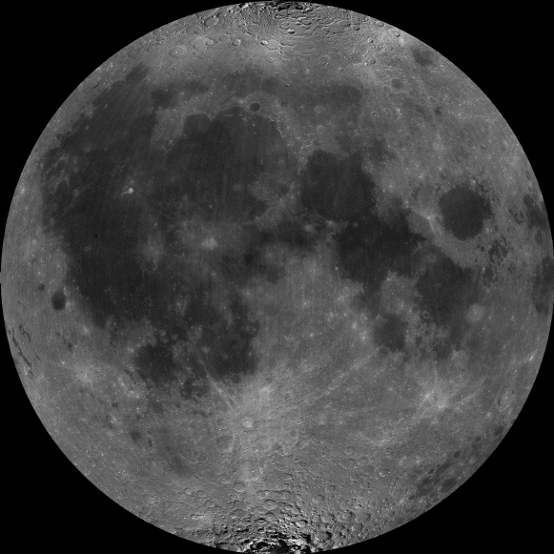
Which body is older, the Earth or the Moon?
Notes:
<number>
<number>

Slide 12
Which body is older, the Earth or the Moon?
Is there a way to know for sure?
Notes:
<number>
<number>
<number>

Slide 13
Which body is older, the Earth or the Moon?
Is there a way to know for sure?
Yes, radioactive dating (to be discussed)
Notes:
<number>
<number>
<number>

Slide 14
Why is the Moon smothered with craters, but the Earth isn't?
Notes:
<number>
<number>

Slide 15
Why is the Moon smothered with craters, but the Earth isn't?
Erosion: resurfacing and weathering.
Notes:
<number>
<number>

Slide 16
What are some types of erosion?
Notes:
<number>
<number>
<number>

Slide 17
What are some types of erosion?
Wind
Rain & water run-off
Oceans & lakes
Vegetation
Plate motions- earthquakes
Volcanoes
Notes:
<number>
<number>
<number>

Slide 18
Why is the Moon smothered with craters, but the Earth isn't?
Does the Earth have any craters?
Notes:
<number>
<number>

Slide 19
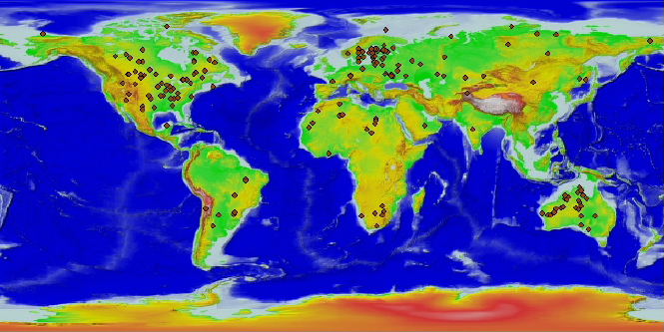
Craters on Earth
Notes:
<number>
<number>
<number>

Slide 20
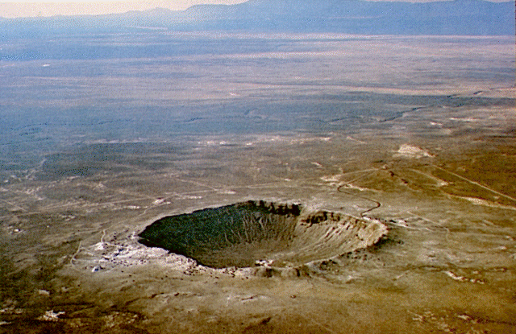
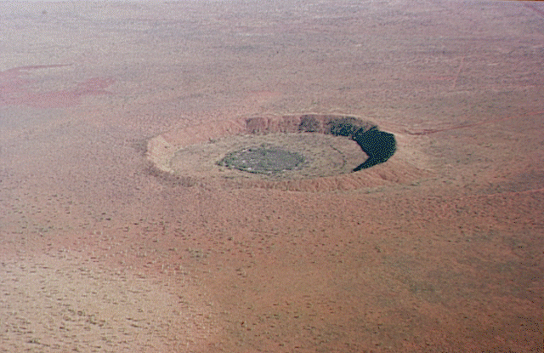
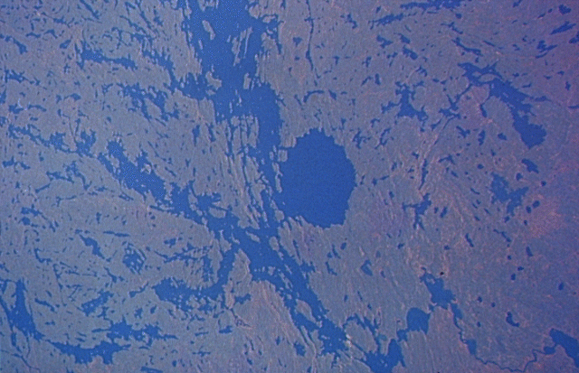
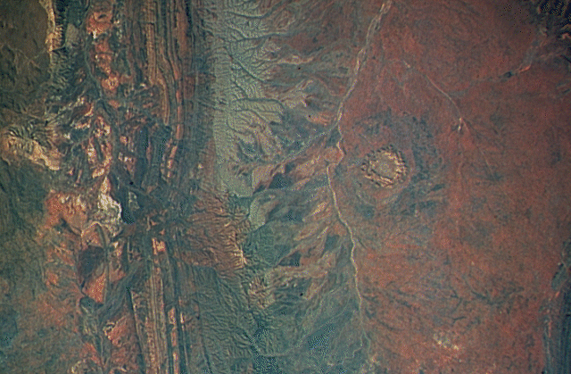
Notes:
<number>
<number>

Slide 21
Back to: How can we determine the age of the Earth? For the surface
We can use radioactive (carbon) dating to tell how old rocks we find are. When rocks solidify, they lock-in the elements they are made of. The ½ life of Carbon 14 (when ½ of the original carbon would have been changed to nitrogen 14) is 5730 years. The ½ life of Potassium 40 (which decays to Argon 40) is 1.25 billion years.
Notes:
<number>
<number>
<number>

Slide 22
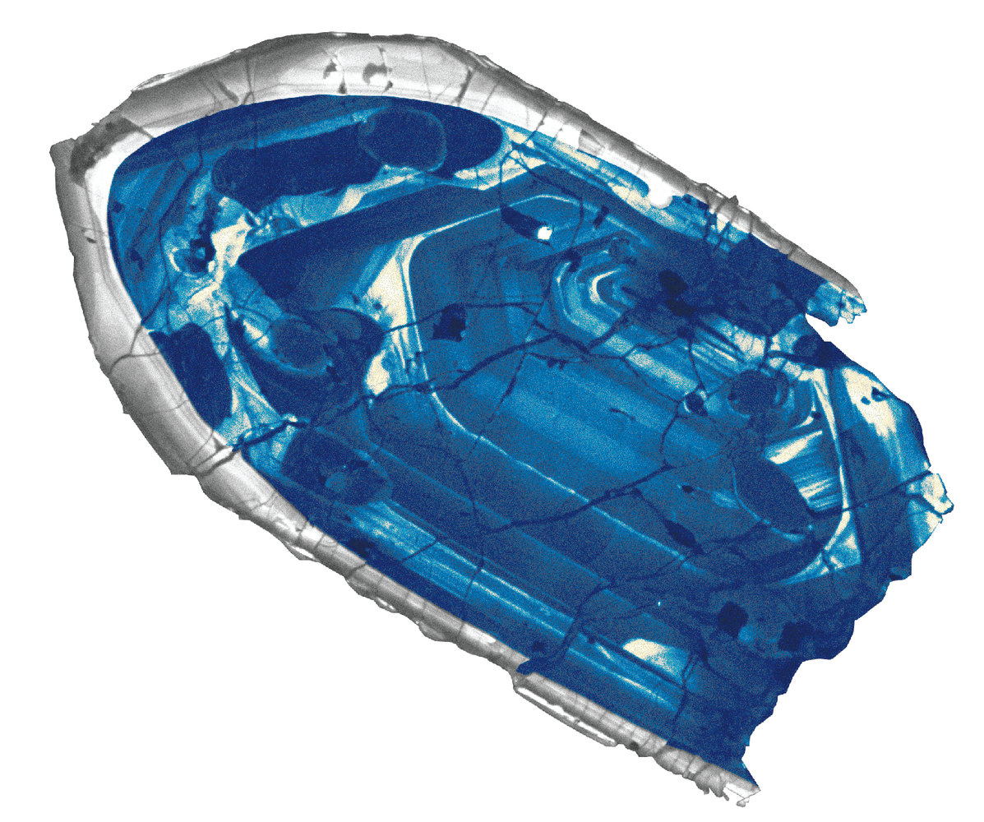
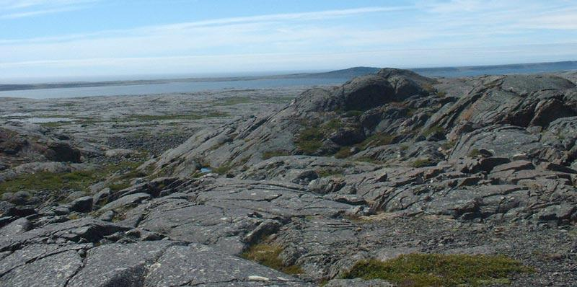
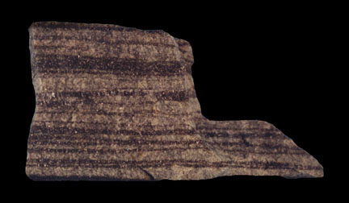
How old is old?
The oldest rocks found on Earth are about 4 billion years old. Yet the average age of the Earth's surface is about 200 million years old.
4.4 Gyr old mineral
4.28 Gyr old rock outrcopping
3.9 Gyr old rock with chemical traces of life
Notes:
<number>
<number>

