Slide 1
“It has been said that politics is the second oldest profession. I have learned it bears a striking resemblance to the first.”
Ronald Reagan

Slide 2
Test 2 on Nov. 4 in class.
Sample Tests and study guide on the course web page next week.
Group project 1 is due (hardcopy) on Nov. 4.
½ class of project work time on Wednesday.
HW4 on the web page now and due next Wednesday.
Any late HW3- turn in no later than Monday. Solutions will be posted Monday after class.

Slide 3
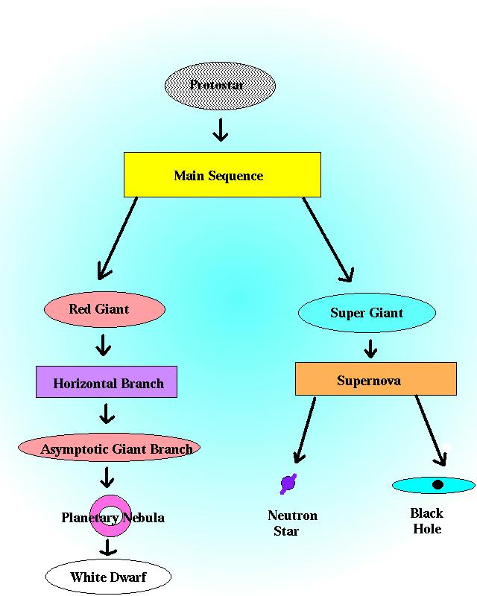
M<8 M>8
M<25<M

Slide 4
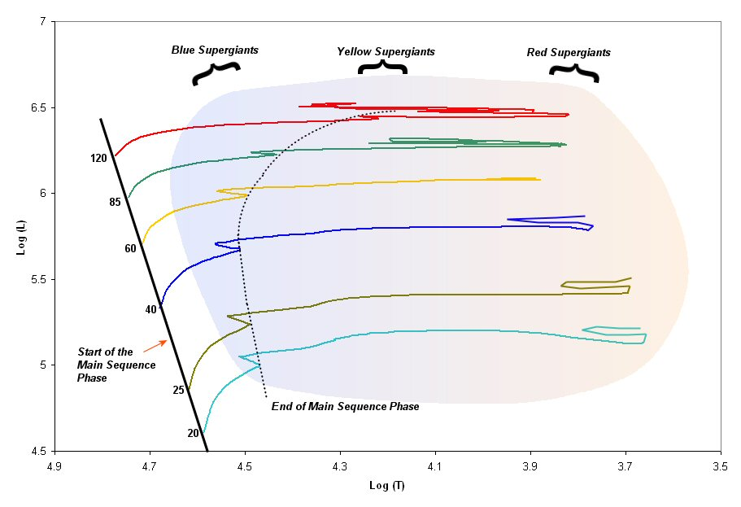
HR Diagram of the high mass side.

Slide 5
End States of Stars: Neutron Stars
For main sequence stars with more than 8, but less than 25 solar masses:
      10 to 30km across. (City-sized)
      Average mass of 1.4 solar masses.
      Cannot get larger than about 2.5 solar masses.
      Most observed as Pulsars

Slide 6
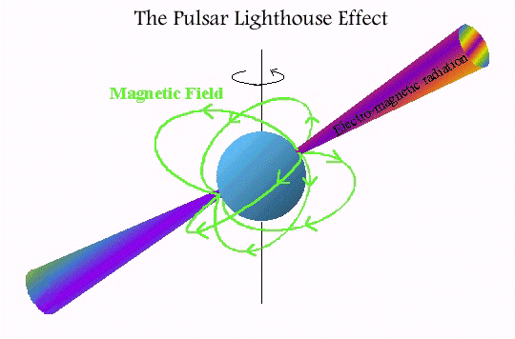

Slide 7
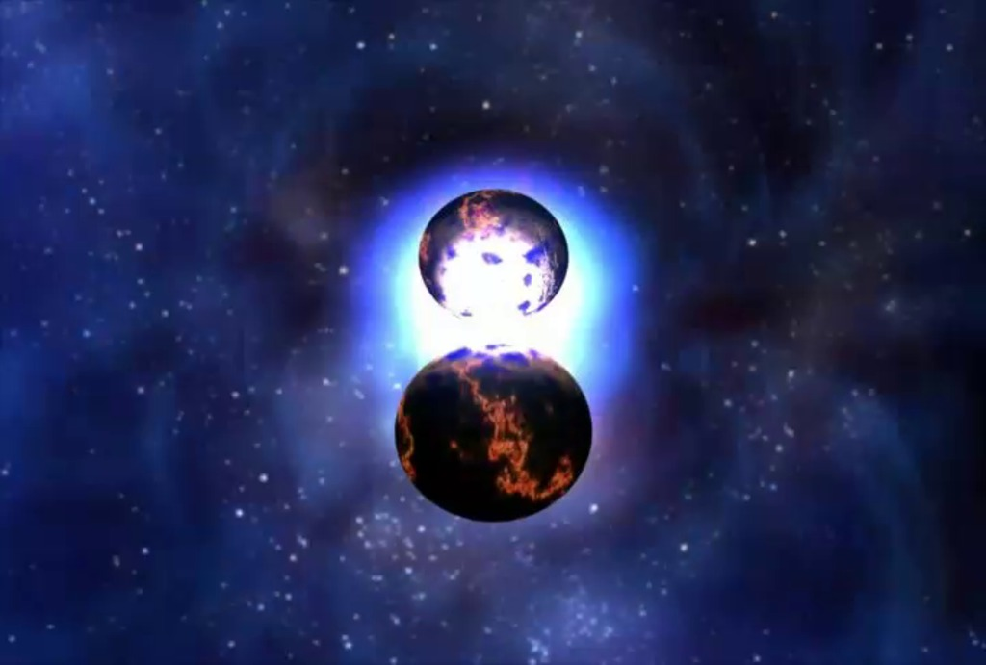
It is estimated that our galaxy already has about 100 million neutron stars.
Only about 1,000 have been detected.

Slide 8
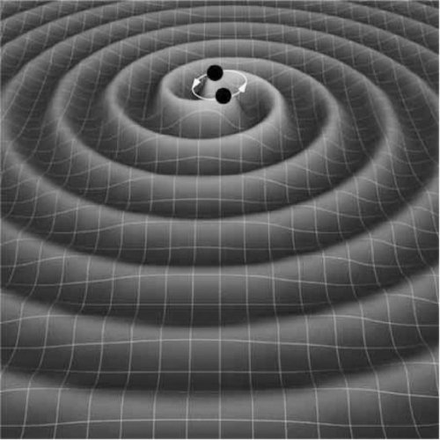
They have been used to (successfully) test the theory of general relativity.

Slide 9
Black Holes
The end product of main sequence stars with mass greater than 25 solar masses.
Nothing can escape- not even light.

Slide 10
Black Holes
Size;
  The black hole itself is a point at the center.
  Nothing can travel faster than light.
  Light travels at a fixed speed: c
  Set the escape velocity (remember that?) to c and solve for size.
  Schwarzchild radius: R_{sch}=3M for mass in solar masses you get size in kilometers.
    Also called the event horizon.

Slide 11
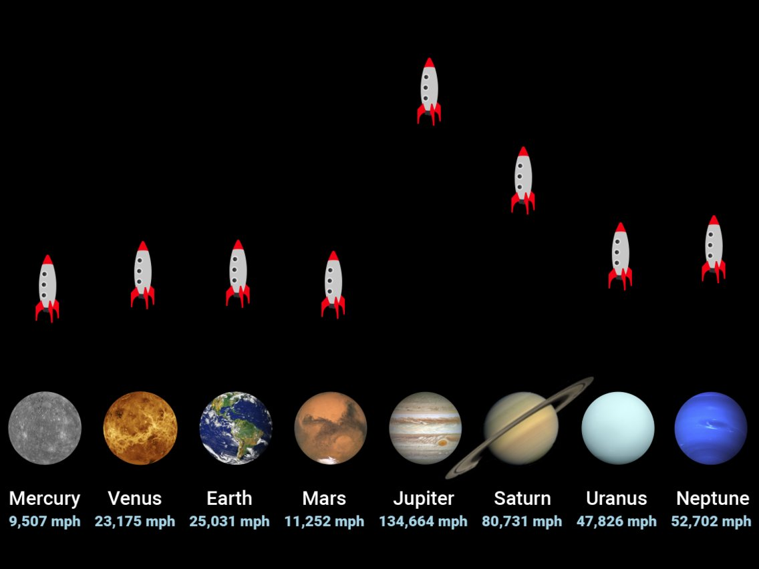
To launch a rocket from any object, that object needs to reach escape speed. Otherwise, it just falls back down.
Listed below are how fast rockets must go if launched from planets in our solar system.
Graphic from Skye Gould/Business Insider

Slide 12
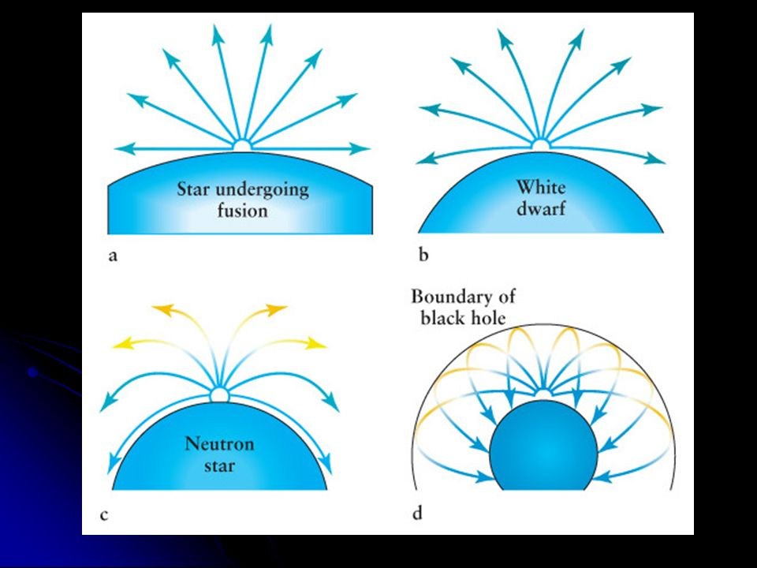
So if we make objects more and more massive, the escape speed gets higher and higher. If that escape speed is larger than the speed of light, then nothing can get out, not even light.
The figure has arrows, showing how light would leave increasingly massive stars.
Graphic from Tabitha Norris

Slide 13
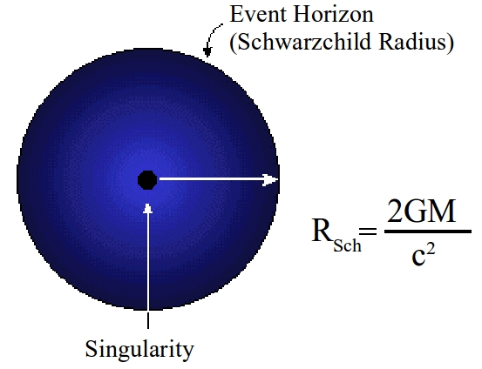
Black Holes
The end product of main sequence stars with mass greater than 25 solar masses.
R_{sch}=3M for mass in solar masses and size in kilometers

Slide 14
Example.
A 97 MSun main sequence star evolves to become a 6.5 MSun black hole. What is its event horizon (Schwarzchild radius) in kilometers?

Slide 15
Example.
A 97 MSun main sequence star evolves to become a 6.5 MSun black hole. What is its event horizon (Schwarzchild radius) in kilometers?
6.5x3 = 19.5 km

Slide 16
Black Holes
The end product of main sequence stars with mass greater than 25 solar masses.
Nothing can escape- not even light.

Slide 17
How do you detect something that doesn't emit light?

Slide 18
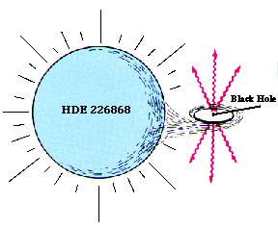
The supergiant star HDE 226868 is 16-18 times more massive than our Sun, yet it orbits a more massive object, which can only be seen in X-rays.

Slide 19
The only object that would fit and be more massive than the star is a black hole.

Slide 20
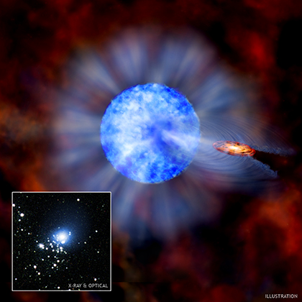
X-7 in M33. The black hole is estimated at 15.7 solar masses and the star at 70 solar masses!

Slide 21
If the star is 70 solar masses, yet less evolved than the companion, how massive must the other star have been on the main sequence?

Slide 22
If the star is 70 solar masses, yet less evolved than the companion, how massive must the other star have been on the main sequence?
It must have been more than 70 solar masses, which only leave behind black holes.

Slide 23
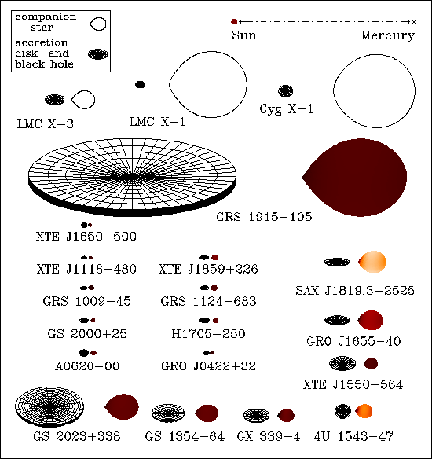
Several binaries with black holes are known.

Slide 24
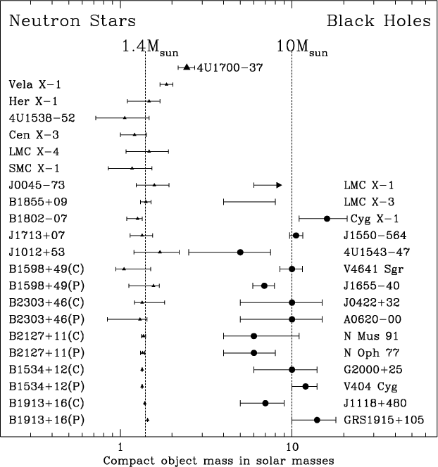
From which masses have been estimated.

Slide 25
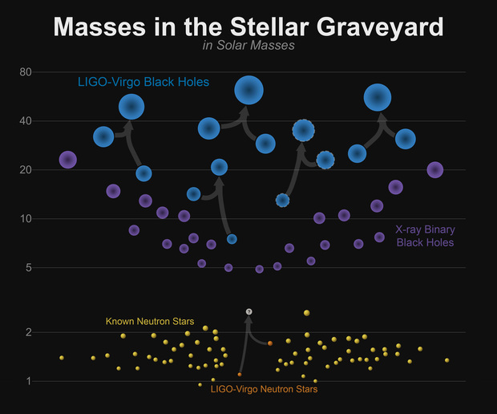
The blue dots are black holes making gravity waves as they merge detected by LIGO. 2 merge into 1 (connected by lines).

Slide 26
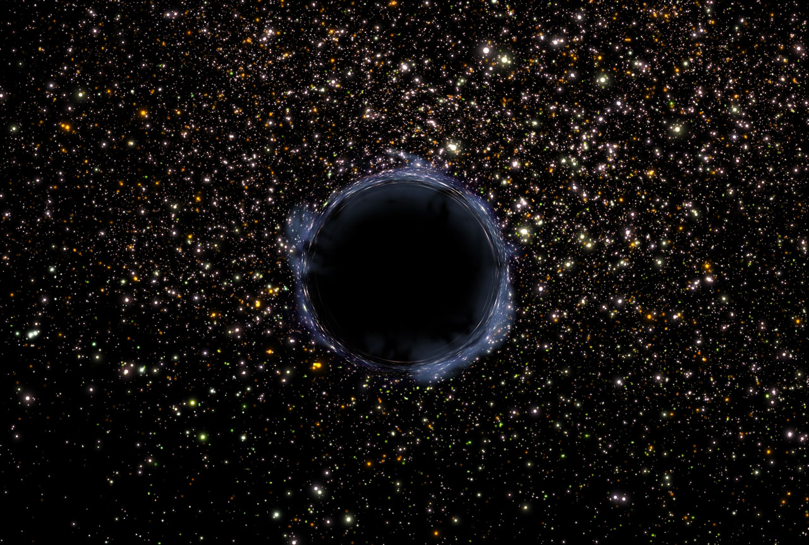
If nothing gets out, what can we measure?

Slide 27
If nothing gets out, what can we measure?
1) Mass. From their gravity.
2) Rotation. This changes the shape of the Schwarzchild radius- making it wider along the spin axis. This has not been done yet, but it could be measured by mapping the event horizon.
3) Charge. There’s no reason to believe black holes have charge (more positive or negative material falls in), but if they do have charge, it could be measured from outside the event horizon.

Slide 28
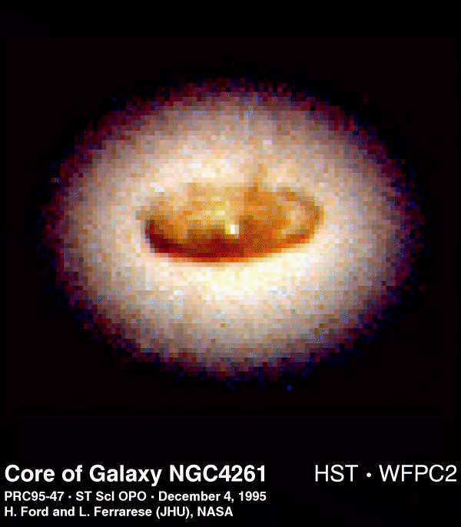
As the material gets ripped apart, it forms a disk around the black hole. This disk is slowly feeding the black hole.
However, friction within the disk makes the material very hot and bright. So although black holes themselves are dark, they are easy to find.

Slide 29
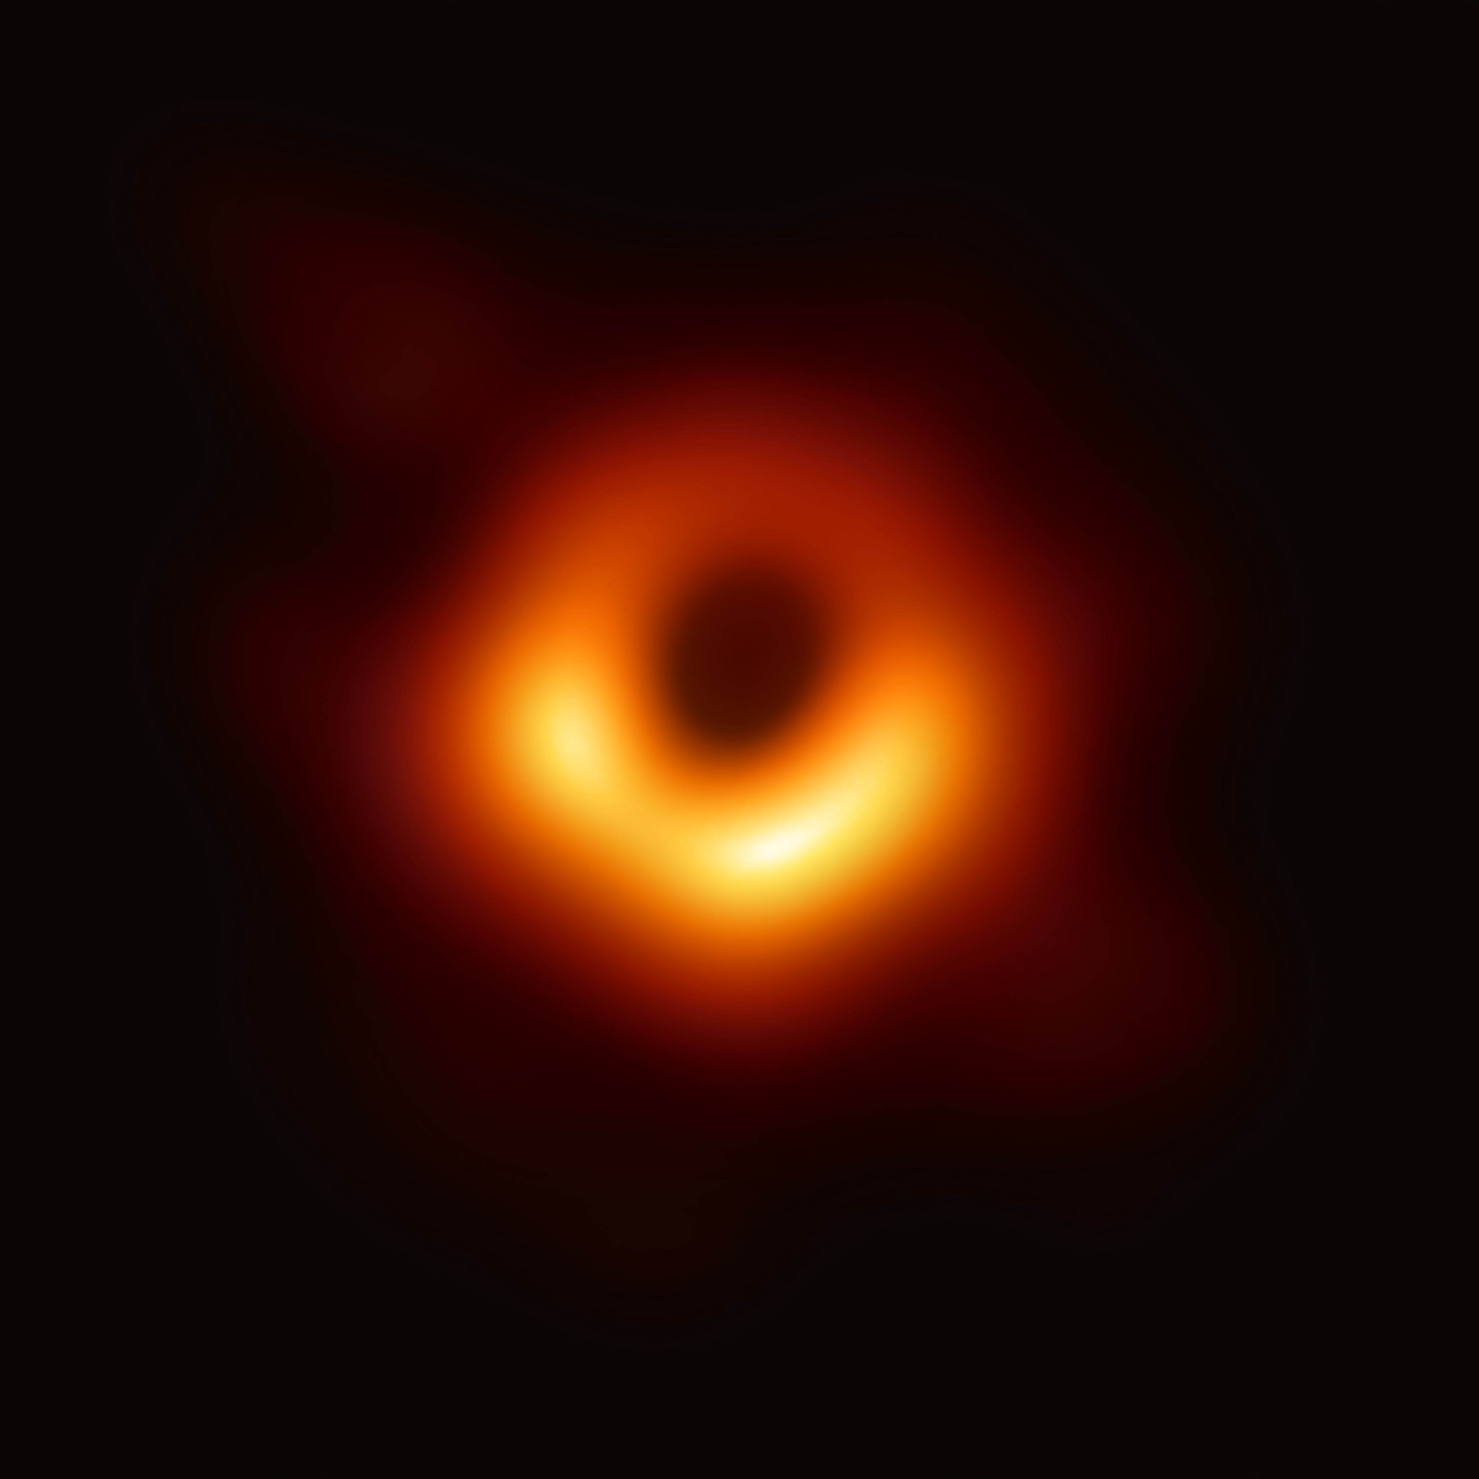

Slide 30
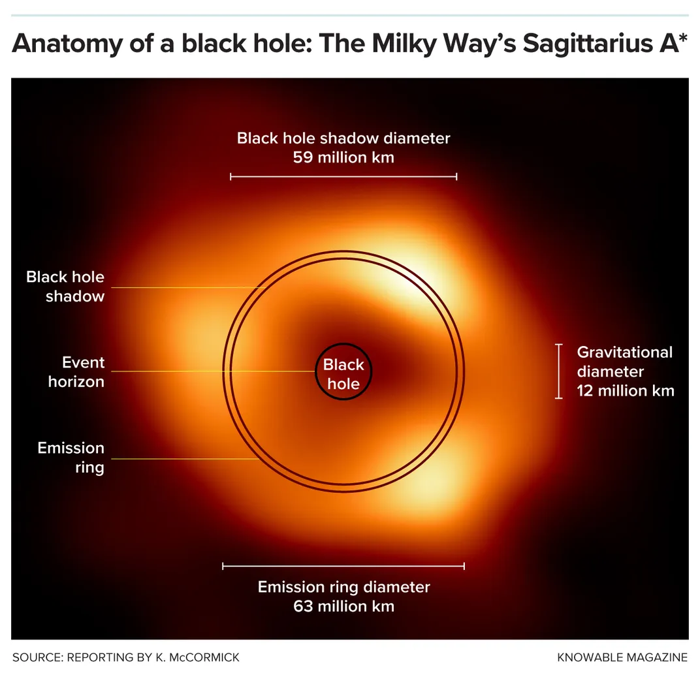

Slide 31
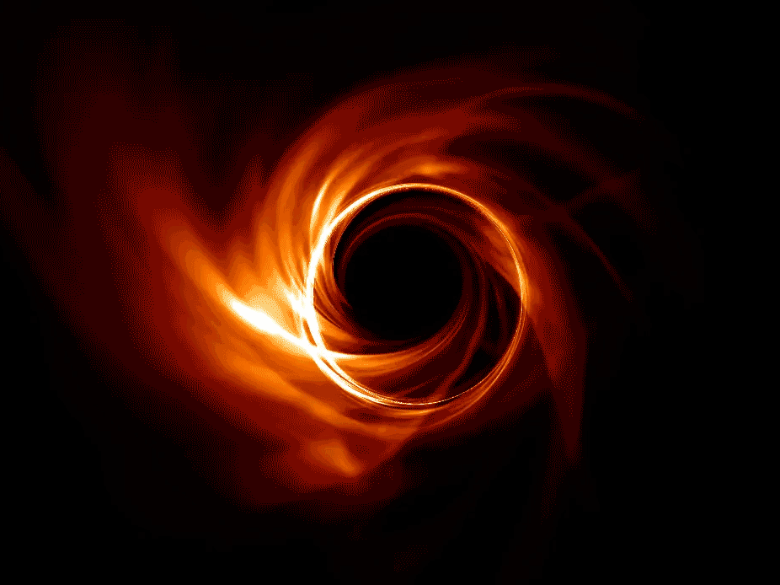

Slide 32
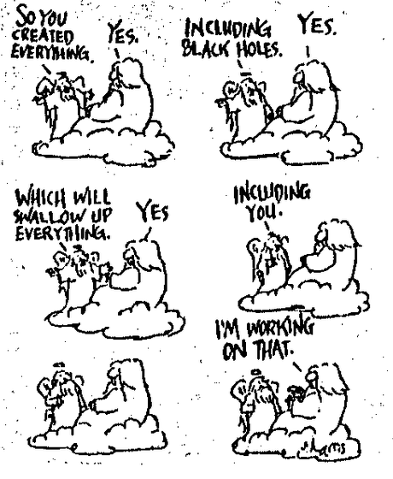
The Wacky World of Black Holes

Slide 33
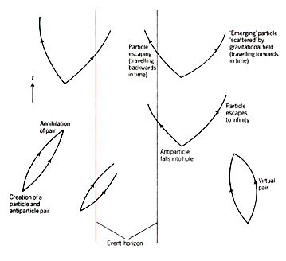
Hawking Radiation
Black holes evaporate!
Notes:
<number>

Slide 34
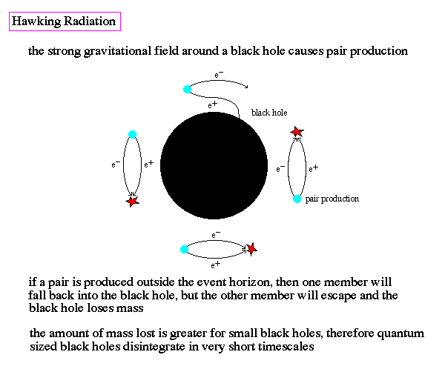
Notes:
<number>

Slide 35
Radiation = Light
As black holes evaporate, they emit blackbody radiation. They are luminous! E=mc²
L ~ 3.6x10³²/M² in units of W/kg²
So smaller black holes evaporate faster!
And the rate at which they evaporate increases as they lose mass.
Notes:
<number>

Slide 36

Eventually, all black holes evaporate.
Notes:
<number>

Slide 37
Eventually, all black holes evaporate.
If our Sun were a black hole, how long would it take to evaporate?
Notes:
<number>

Slide 38
Eventually, all black holes evaporate.
What if Jupiter (0.001M_{Sun}) became a black hole, how long would it take to evaporate?
Notes:
<number>

Slide 39
Eventually, all black holes evaporate.
What if Jupiter (0.001M_{Sun}) became a black hole, how long would it take to evaporate?
Still 10⁵⁷ years. That’s 100000000000000000000000000000000000000000000000000000000 years
Notes:
<number>

Slide 40
Takeaways:
Eventually black holes evaporate (go away).
Black holes are not vacuum cleaners, they cannot ‘suck in’ the Universe.
If our Sun became a black hole (which it won’t), the Earth would still orbit exactly as it does now.

Slide 41
Falling into a black hole.
Notes:
<number>

Slide 42
Falling into a black hole
Effect #1: Tidal forces- they're a killer!
As you get near a black hole, your feet try to fall faster than your head. This is a problem!
Notes:
<number>

Slide 43
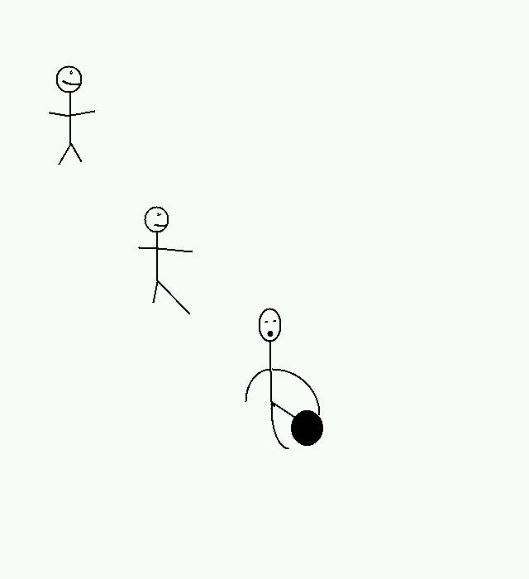
Here's poor stickman falling into a black hole. As he gets closer, he gets stretched out.
Notes:
<number>

Slide 44
Falling into a black hole
But tidal forces are not the only problem. As light has to fight gravity to escape, some of its energy is lost. As light loses energy it becomes redder. So things falling into a black hole become redshifted.
The closer they get, the more redshift affects them.
Notes:
<number>

Slide 45
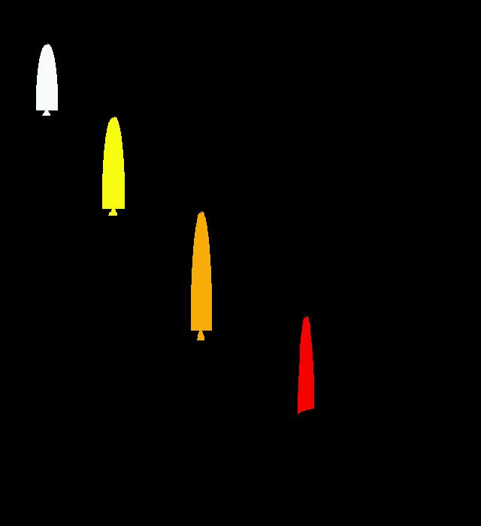
As the rocket falls into the black hole, it gets redder, and would actually fade out of sight.
Notes:
<number>

Slide 46
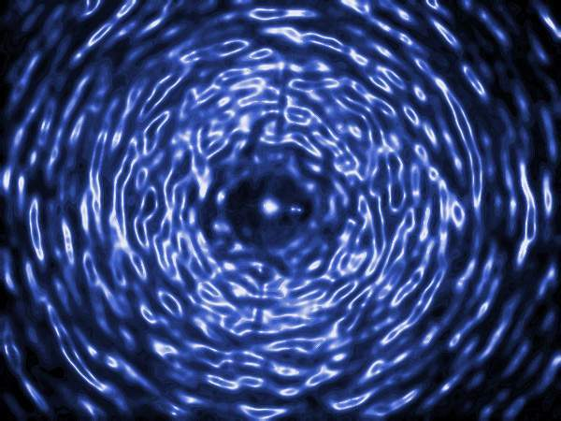
Wormholes
Notes:
<number>

Slide 47
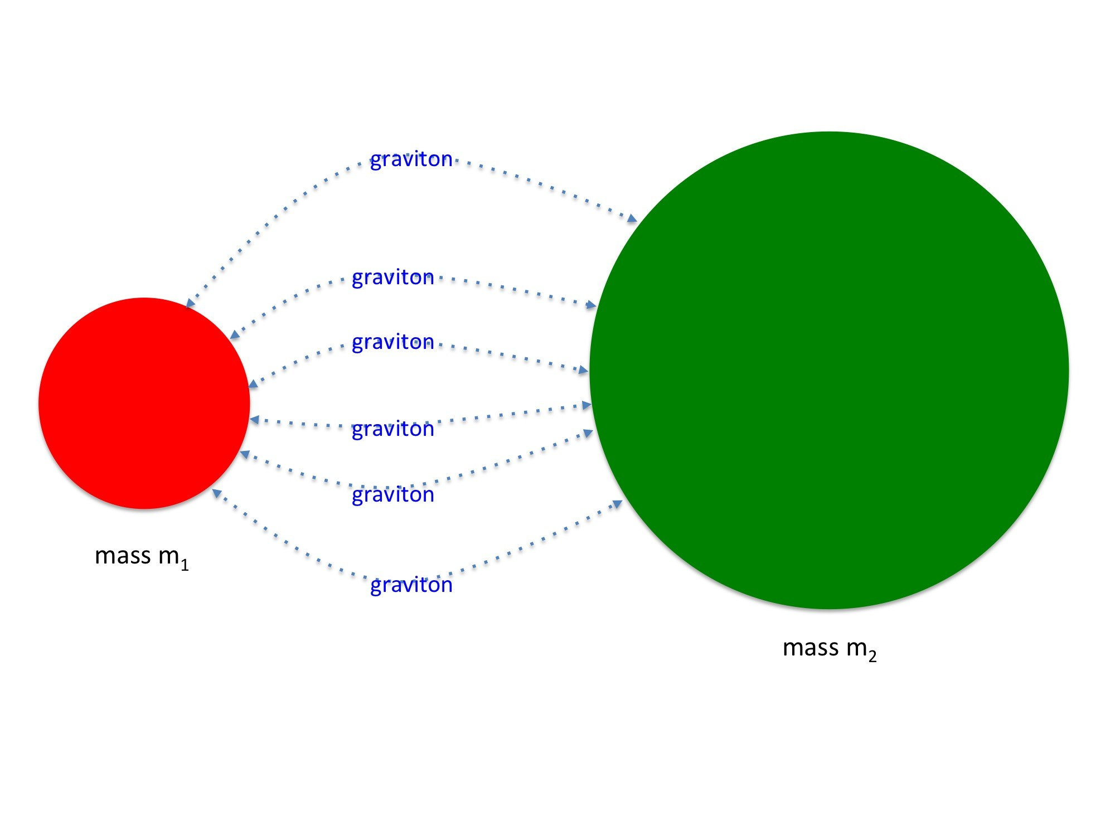
The Graviton: A gravity analogy to the photon
Notes:
<number>

Slide 48
Wormhole Ingredients
Be able to control gravitons
Make anti-gravitons
Bend space using (anti-)gravitons.
Connect both pieces of space using (anti-)gravitons
Hold hole open using anti-gravitons
Notes:
<number>

Slide 49
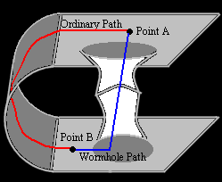
Notes:
<number>

Slide 50

How to build a time machine.
Notes:
<number>

Slide 51
Time machine ingredients
1) Build 2 black holes.
2) Connect the black holes with a wormhole.
3) Move one of the black holes near the speed of light for a very long time (let's say 0.9c for 200 years)
4) Travel through the still wormhole to the moving one. (You've gone back 113 years!)
Notes:
<number>

Slide 52
A thought experiment
Imagine what we could do if we could control the graviton (gravitational fields) the same way we can control the photon, or the electron (electric fields).
Notes:
<number>

Slide 53

Back to
Notes:
<number>

Slide 54
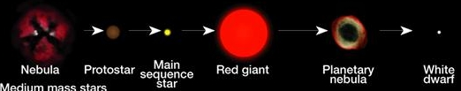
For the rest of space....
Chemical Enrichment:
Planetary nebula and supernova
Our solar system 2% metals
Planetary nebula returns 3% metals
Before our Sun?
Previous star:
1% metals
Planetary nebula returns 2% metals
And before that?
Previous star:
0.5% metals
Planetary nebula returns 1% metals

Slide 55
Stellar Populations
Right now, our Sun has about 2% 'metals'. When it dies, the nebula will have 3-4% 'metals'.
The star before our Sun was created with ~1% 'metals'. What if we keep going backwards?

Slide 56
Stellar Populations
As stars recycle heavier material back into space, newly formed stars incorporate this material.
Thus newer stars have more “metals” then old stars. This gives us populations:
I: Stars like our Sun- they have the most metals (2%)
II: Metal-poor stars- formed in the galaxy before our Sun: have some, but little metals (<0.1%)
III: No metals at all: made only of H and He. The first stars.

